Slide 1
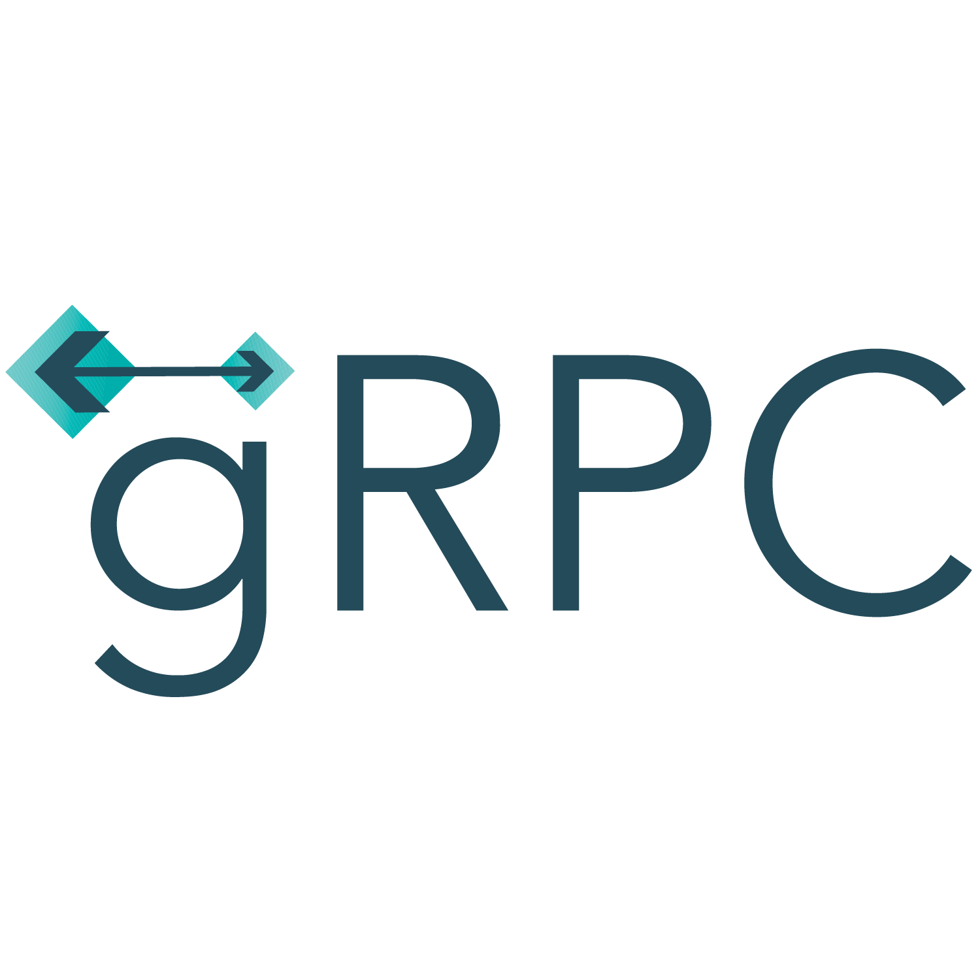
gRPC on .NET
Lets Grow

Slide 2
gPRC is a language agnotic, high-performance Remote Procedure Call Framework

Slide 3
Main benefits
Modern, high-performance, lightweight RPC framework.
Contract-first API development, using Protocol Buffers by default, allowing for language agnostic implementations.
Tooling available for many languages to generate strongly-typed servers and clients.
Supports client, server, and bi-directional streaming calls.
Reduced network usage with Protobuf binary serialization.

Slide 4
The benefits make gRPC ideal for
Lightweight microservices where efficiency is critical.
Polyglot systems where multiple languages are required for development.
Point-to-point real-time services that need to handle streaming requests or responses

Slide 5
SOAP vs REST vs GraphQL vs RPC
Two separate applications need an intermediary to talk to each other. So, developers often build bridges – Application Programming Interfaces – to allow one system to access the information or functionality of another.
In order to integrate applications quickly and at scale, APIs are realized using protocols and/or specifications to define the semantics and syntax of the messages passed across the wire. These specifications make up the API architecture.
Over time, different API architectural styles have been released. Each of them has its own patterns of standardizing data exchange. A pull of choices raises endless debates as to which architectural style is best.

Slide 6
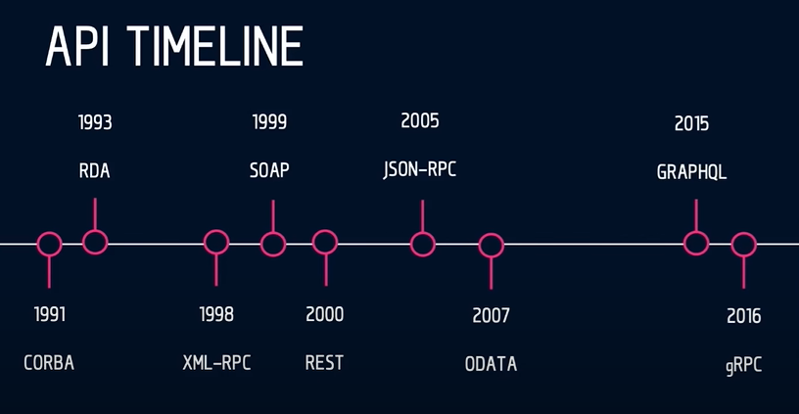

Slide 7
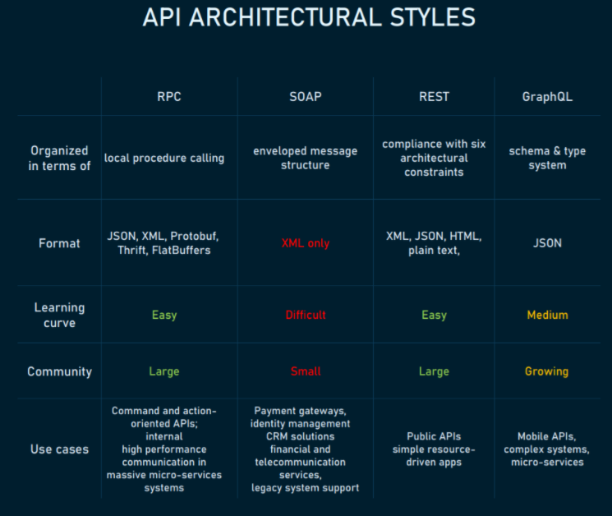

Slide 8
Remote Procedure Call (RPC): invoking a function on another system
A Remote Procedure Call is a specification that allows for remote execution of a function in a different context. RPC extends the notion of local procedure calling but puts it in the context of an HTTP API.
Initial XML-RPC was problematic because ensuring data types of XML payloads is tough. So, later an RPC API started using a more concrete JSON-RPC specification which is considered a simpler alternative to SOAP. gRPC is the latest RPC version developed by Google in 2015. With pluggable support for load balancing, tracing, health checking, and authentication, gRPC is well-suited for connecting microservices.

Slide 9
How RPC works
A client invokes a remote procedure, serializes the parameters and additional information into a message, and sends the message to a server. On receiving the message, the server deserializes its content, executes the requested operation, and sends a result back to the client. The server stub and client stub take care of the serialization and deserialization of the parameters.

Slide 10
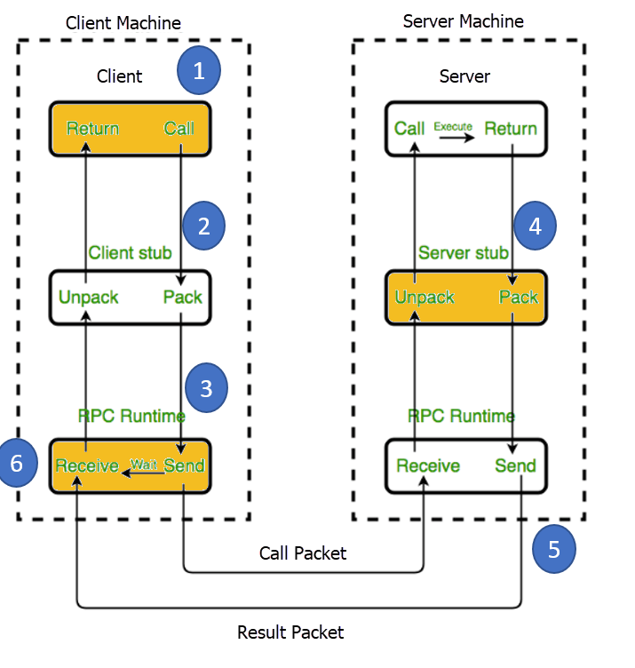

Slide 11
RPC Pros
Straightforward and simple interaction. RPC uses GET to fetch information and POST for everything else. The mechanics of the interaction between a server and a client come down to calling an endpoint and getting a response.
Easy-to-add functions. If we get a new requirement for our API, we can easily add another endpoint executing this requirement: 1) Write a new function and throw it behind an endpoint and 2) now a client can hit this endpoint and get the info meeting the set requirement.
High performance. Lightweight payloads go easy on the network providing high performance, which is important for shared servers and for parallel computations executing on networks of workstations. RPC is able to optimize the network layer and make it very efficient with sending tons of messages per day between different services.

Slide 12
RPC Cons
Tight coupling to the underlying system. An API’s abstraction level contributes to its reusability. The tighter it is to the underlying system, the less reusable it will be for other systems. RPC’s tight coupling to the underlying system doesn’t allow for an abstraction layer between the functions in the system and the external API. This raises security issues as it’s quite easy to leak implementation details about the underlying system into the API. An RPC’s tight coupling makes scalability requirements and loosely coupled teams hard to achieve. So, the client either worries about any possible side effects of calling a particular endpoint or tries figuring out what endpoint to call because it doesn’t understand how the server is naming its functions.
Low discoverability. In RPC there’s no way to introspect the API or send a request and start understanding what function to call based on its requests.
Function explosion. It’s so easy to create new functions. So, instead of editing the existing ones, we create new ones ending up with a huge list of overlapping functions that are hard to understand.

Slide 13
RPC Use Cases
Command API. An RPC is the proper choice for sending commands to a remote system. For instance, a Slack API is very command-focused: Join a channel, leave a channel, send a message. So, the designers of the Slack API modeled it in an RPC-like style making it small, tight, and easy to use.
Customer-specific APIs for internal microservices. Having direct integration between a single provider and consumer, we don’t want to spend a lot of time transmitting a lot of metadata over the wire, like a REST API does. With high message rate and message performance, gRPC and Twirp are strong cases for microservices. Using HTTP 2 under the hood, gRPC is able to optimize the network layer and make it very efficient with sending tons of messages per day between different services. However, if you’re not aiming at high network performance, but rather at a stable API contact between teams publishing highly distinctive microservices, REST will ensure that.

Slide 14
Simple Object Access Protocol (SOAP)
SOAP is an XML-formatted, highly standardized web communication protocol. Released by Microsoft a year after XML-RPC, SOAP inherited a lot from it. When REST followed, they were first used in parallel, but soon REST won the popularity contest.
How SOAP works
XML data format drags behind a lot of formality. Paired with the massive message structure, it makes SOAP the most verbose API style.
A SOAP message is composed of:
an envelope tag that begins and ends every message,
a body containing the request or response
a header if a message must determine any specifics or extra requirements, and
a fault informing of any errors that can occur throughout the request processing.

Slide 15
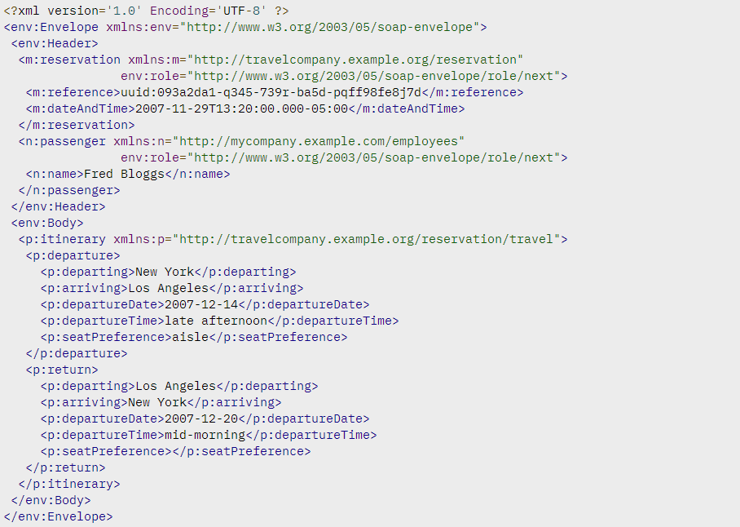

Slide 16
SOAP Pros
Language- and platform-agnostic. The built-in functionality to create web-based services allows SOAP to handle communications and make responses language- and platform-independent.
Bound to a variety of transport protocols. SOAP is flexible in terms of transfer protocols to accommodate for multiple scenarios.
Built-in error handling. SOAP API specification allows for returning the Retry XML message with error code and its explanation.
A number of security extensions. Integrated with the WS-Security protocols, SOAP meets an enterprise-grade transaction quality. It provides privacy and integrity inside the transactions while allowing for encryption on the message level.

Slide 17
SOAP cons
XML only. SOAP messages contain a lot of metadata and only support verbose XML structures for requests and responses.
Heavyweight. Due to the large size of XML-files, SOAP services require a large bandwidth.
Narrowly specialized knowledge. Building SOAP API servers requires a deep understanding of all protocols involved and their highly restricted rules.
Tedious message updating. Requiring additional effort to add or remove the message properties, rigid SOAP schema slows down adoption.

Slide 18
SOAP use cases
Right now, the SOAP architecture is most commonly used for internal integration within enterprises or with their trusted partners.
Highly secured data transmission. SOAP rigid structure, security and authorization capabilities make it the most suitable option for enforcing a formal software contract between API and client while complying with the legal contract between the API provider and API consumer. That’s why financial organizations and other corporate users opt for SOAP.

Slide 19
Representational state transfer (REST): making data available as resources
REST is a self-explanatory API architectural style defined by a set of architectural constraints and intended for wide adoption with many API consumers.
The most common API style today was originally described in 2000 by Roy Fielding in his doctoral dissertation. REST makes server-side data available representing it in simple formats, often JSON and XML.

Slide 20
How REST works
REST isn’t as strictly defined as SOAP. RESTful architecture should comply with six architectural constraints:
uniform interface: permitting a uniform way of interacting with a given server regardless of device or application type
stateless: the necessary state to handle the request as contained within the request itself and without the server storing anything related to the session
caching
client-server architecture: allowing for independent evolution of either side
layered system of the application
the ability for servers to provide executable code to the client

Slide 21
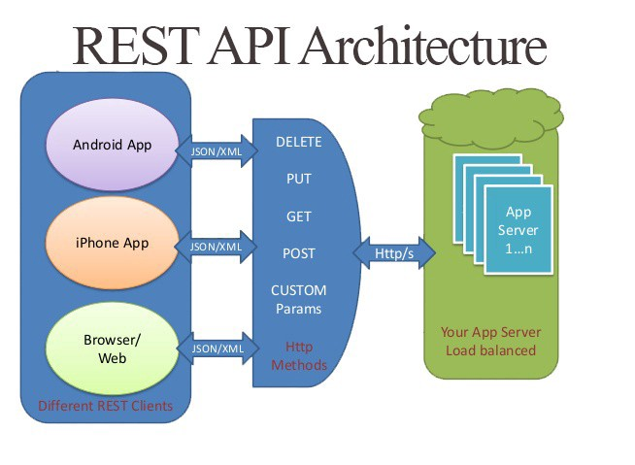

Slide 22
REST Pros
Decoupled client and server. Decoupling the client and the server as much as possible, REST allows for a better abstraction than RPC. A system with abstraction levels is able to encapsulate its details to better identify and sustain its properties. This makes a REST API flexible enough to evolve over time while remaining a stable system.
Discoverability. Communication between the client and server describes everything so that no external documentation is required to understand how to interact with the REST API.
Cache-friendly. Reusing a lot of HTTP tools, REST is the only style that allows caching data on the HTTP level. In contrast, caching implementation on any other API will require configuring an additional cache module.
Multiple formats support. The ability to support multiple formats for storing and exchanging data is one of the reasons REST is currently a prevailing choice for building public APIs.

Slide 23
REST Cons
No single REST structure. There’s no exact right way to build a REST API. How to model resources and which resources to model will depend on each scenario. This makes REST simple in theory, but difficult in practice.
Big payloads. REST returns a lot of rich metadata so that the client can understand everything necessary about the state of the application just from its responses. And this chattiness is no big deal for a big network pipe with lots of bandwidth capacity. But that’s not always the case. This was the key driving factor for Facebook coming up with the description of GraphQL style in 2012.
Over- and under-fetching problems. Containing either too much data or not enough of it, REST responses often create the need for another request.

Slide 24
REST use cases
Management APIs. APIs focused on managing objects in a system and intended for many consumers are the most common API type. REST helps such APIs to have strong discoverability, good documentation, and it fits this object model well.
Simple resource-driven apps. REST is a valuable approach for connecting resource-driven apps that don’t need flexibility in queries.

Slide 25
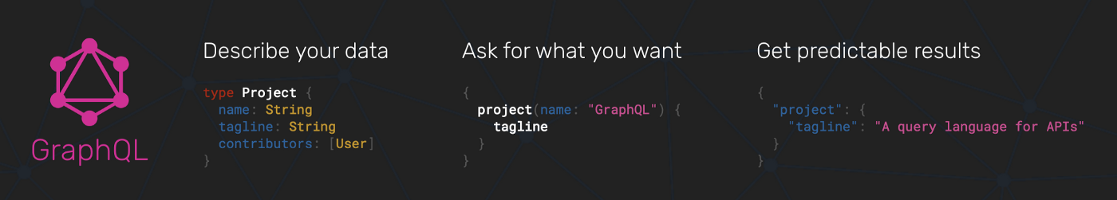
GraphQL: querying just the needed data
It takes a number of calls to the REST API for it to return the needed staff. So GraphQL was invented to be a game-changer.
GraphQL is a syntax that describes how to make a precise data request. Implementing GraphQL is worth it for an application’s data model with a lot of complex entities referencing each other.

Slide 26
How GraphQL works
GraphQL starts with building a schema, which is a description of all the queries you can possibly make in a GraphQL API and all the types that they return. Schema-building is hard as it requires strong typing in the Schema Definition Language (SDL).
Having the schema before querying, a client can validate their query against making sure the server will be able to respond to it. On reaching the backend application, a GraphQL operation is interpreted against the entire schema, and resolved with data for the frontend application. Sending one massive query to the server, the API returns a JSON response with exactly the shape of the data we asked for.

Slide 27
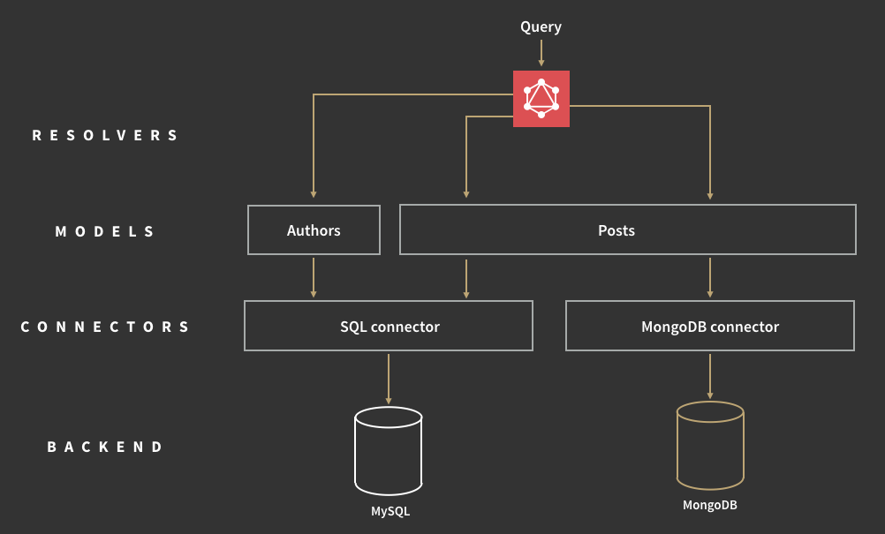

Slide 28
GraphQL pros
Typed schema. GraphQL publishes in advance what it can do, which improves its discoverability. By pointing a client at the GraphQL API, we can find out what queries are available.
Fits graph-like data very well. Data that goes far into linked relations but not good for flat data.
No versioning. The best practice with versioning is not to version the API at all.
While REST offers multiple API versions, GraphQL uses a single, evolving version that gives continuous access to new features and contributes to cleaner, more maintainable server code.
Detailed error messages. In a similar fashion to SOAP, GraphQL provides details to errors that occurred. Its error message includes all the resolvers and refers to the exact query part at fault.
Flexible permissions. GraphQL allows for selectively exposing certain functions while preserving private information. Meanwhile, REST architecture doesn’t reveal data in portions. It’s either all or nothing.

Slide 29
GraphQL cons
Performance issues. GraphQL trades off complexity for its power. Having too many nested fields in one request can lead to system overload. So, REST remains a better option for complex queries.
Caching complexity. As GraphQL isn’t reusing HTTP caching semantics, it requires a custom caching effort.
A lot of pre-development education. Not having enough time to figure out GraphQL niche operations and SDL, many projects decide to follow the well-known path of REST.

Slide 30
GraphQL use cases
Mobile API. In this case, network performance and single message payload optimization is important. So, GraphQL offers a more efficient data loading for mobile devices.
Complex systems and microservices. GraphQL is able to hide the complexity of multiple systems integration behind its API. Aggregating data from multiple places, it merges them into one global schema. This is particularly relevant for legacy infrastructures or third-party APIs that have expanded over time.

Slide 31
Which API patterns fits your use case best?
Every API project has different requirements and needs. Usually, the architectural choice depends on
the programming language in use,
the environment in which you’re developing, and
the resources you have to spare, both human and financial.
Knowing all the tradeoffs that go into each design style, API designers can pick the one that’s going to fit the project best.

Slide 32
Which API pattern
With its tight coupling, RPC works for internal microservices but it’s not an option for a strong external API or an API service.
SOAP is troublesome but its rich security features remain irreplaceable for billing operations, booking systems, and payments.
REST has the highest abstraction and best modeling of the API. But it tends to be heavier on the wire and chattier – a downside if you’re working on mobile.
GraphQL is a big step forward in terms of data fetching but not everyone has enough time and effort to get the hang of it.
At the end of the day, it makes sense to try a few small use cases with a particular style, and see if it fits your use case and solves your problems. If it does, try expanding and see if it fits more use cases.

Slide 34
Proto file
gRPC uses a contract-first approach to API development. Protocol buffers (protobuf) are used as the Interface Definition Language (IDL) by default. The .proto file contains:
The definition of the gRPC service.
The messages sent between clients and servers.
For more information on the syntax of protobuf files, see Create Protobuf messages for .NET apps.

Slide 35
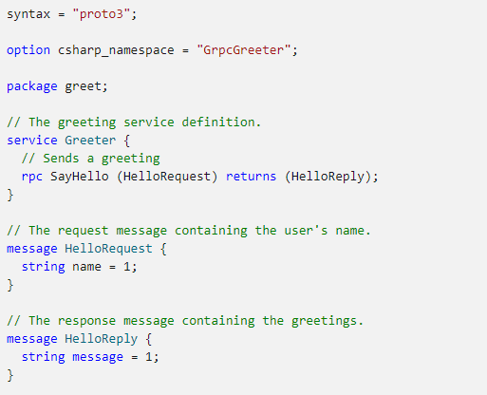
Proto file (2)
Defines a Greeter service
Defines a SayHello call
SayHello send HelloRequest msg
SayHello receives HelloReply msg

Slide 36

Add a .proto file to a C# app
The .proto file is included in a project by adding it to the <Protobuf> item group:
By default, a <Protobuf> reference generates a concrete client and a service base class. The reference element's GrpcServices attribute can be used to limit C# asset generation. Valid GrpcServices options are:
Both (default when not present)
Server
Client
None

Slide 37
C# Tooling support for .proto files
The tooling package Grpc.Tools is required to generate the C# assets from .proto files. The generated assets (files):
Are generated on an as-needed basis each time the project is built.
Aren't added to the project or checked into source control.
Are a build artifact contained in the obj directory.
This package is required by both the server and client projects. The Grpc.AspNetCore metapackage includes a reference to Grpc.Tools. Server projects can add Grpc.AspNetCore using the Package Manager in Visual Studio or by adding a <PackageReference> to the project file:

Slide 38
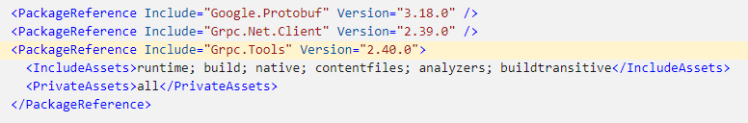
Client projects should directly reference Grpc.Tools alongside the other packages required to use the gRPC client. The tooling package isn't required at runtime, so the dependency is marked with PrivateAssets="All":

Slide 39
Generated C# assets
The tooling package generates the C# types representing the messages defined in the included .proto files.
For server-side assets, an abstract service base type is generated. The base type contains the definitions of all the gRPC calls contained in the .proto file. Create a concrete service implementation that derives from this base type and implements the logic for the gRPC calls. For the greet.proto, the example described previously, an abstract GreeterBase type that contains a virtual SayHello method is generated. A concrete implementation GreeterService overrides the method and implements the logic handling the gRPC call.

Slide 40
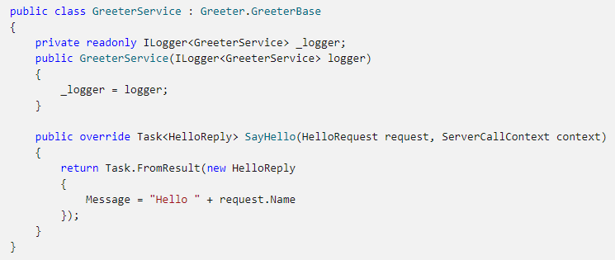

Slide 41
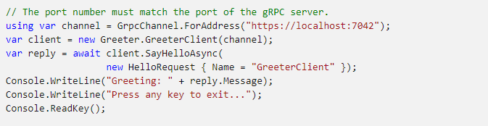
For client-side assets, a concrete client type is generated. The gRPC calls in the .proto file are translated into methods on the concrete type, which can be called. For the greet.proto, the example described previously, a concrete GreeterClient type is generated. Call GreeterClient.SayHelloAsync to initiate a gRPC call to the server.

Slide 42

By default, server and client assets are generated for each .proto file included in the <Protobuf> item group. To ensure only the server assets are generated in a server project, the GrpcServices attribute is set to Server.
Similarly, the attribute is set to Client in client projects.

Slide 43
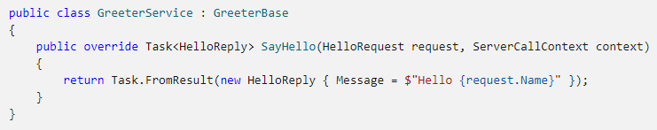
Create new gRPC services
By default the generated GreeterBase doesn't do anything. Its virtual SayHello method will return an UNIMPLEMENTED error to any clients that call it. For the service to be useful an app must create a concrete implementation of GreeterBase:

Slide 44

The ServerCallContext gives the context for a server-side call.
The service implementation is registered with the app. If the service is hosted by ASP.NET Core gRPC, it should be added to the routing pipeline with the MapGrpcService method.

Slide 45
Implement gRPC methods
A gRPC service can have different types of methods. How messages are sent and received by a service depends on the type of method defined. The gRPC method types are:
Unary
Server streaming
Client streaming
Bi-directional streaming
Streaming calls are specified with the stream keyword in the .proto file. stream can be placed on a call's request message, response message, or both.

Slide 46
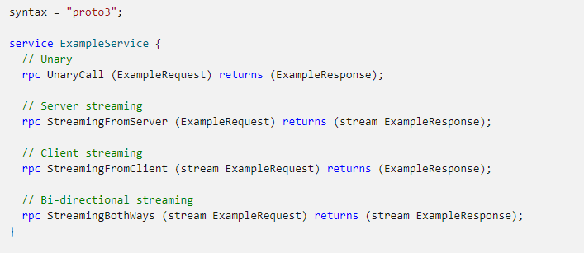

Slide 47
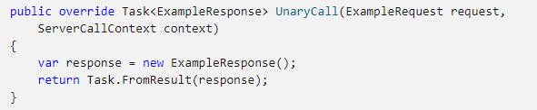

Unary Method
A unary method gets the request message as a parameter, and returns the response. A unary call is complete when the response is returned.
Unary calls are the most similar to actions on web API controllers. One important difference gRPC methods have from actions is gRPC methods are not able to bind parts of a request to different method arguments. gRPC methods always have one message argument for the incoming request data. Multiple values can still be sent to a gRPC service by making them fields on the request message:

Slide 48
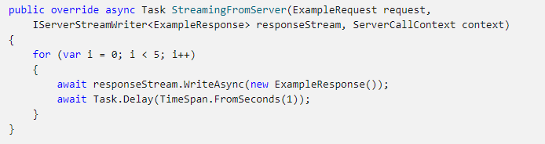
Server streaming method
A server streaming method gets the request message as a parameter. Because multiple messages can be streamed back to the caller, responseStream.WriteAsync is used to send response messages. A server streaming call is complete when the method returns.

Slide 49
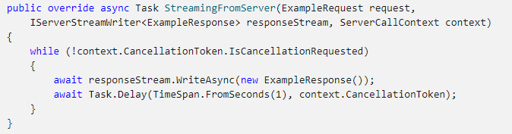
The client has no way to send additional messages or data once the server streaming method has started. Some streaming methods are designed to run forever. For continuous streaming methods, a client can cancel the call when it's no longer needed. When cancellation happens the client sends a signal to the server and the ServerCallContext.CancellationToken is raised. The CancellationToken token should be used on the server with async methods so that:
Any asynchronous work is canceled together with the streaming call.
The method exits quickly.

Slide 50
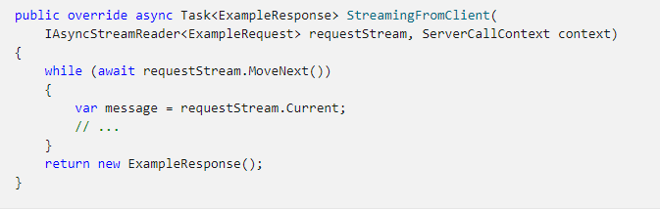
Client streaming method
A client streaming method starts without the method receiving a message. The requestStream parameter is used to read messages from the client. A client streaming call is complete when a response message is returned:

Slide 51
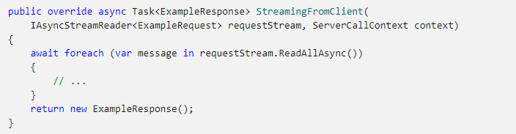
When using C# 8 or later, the await foreach syntax can be used to read messages. The IAsyncStreamReader<T>.ReadAllAsync() extension method reads all messages from the request stream:

Slide 52
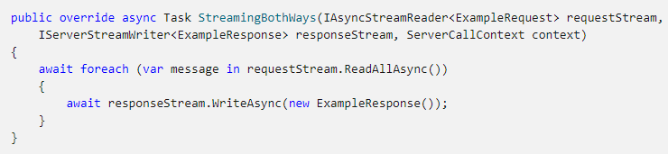
Bi-directional streaming method
A bi-directional streaming method starts without the method receiving a message. The requestStream parameter is used to read messages from the client. The method can choose to send messages with responseStream.WriteAsync. A bi-directional streaming call is complete when the method returns:
The preceding code:
Sends a response for each request.
Is a basic usage of bi-directional streaming.

Slide 53
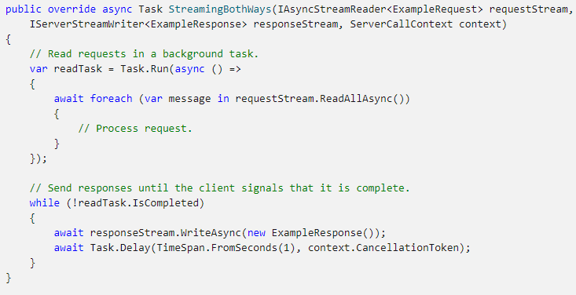
It is possible to support more complex scenarios, such as reading requests and sending responses simultaneously:
In a bi-directional streaming method, the client and service can send messages to each other at any time. The best implementation of a bi-directional method varies depending upon requirements.

Slide 54
Call gRPC services with the .NET client
A .NET gRPC client library is available in the Grpc.Net.Client NuGet package. We are now going to look at:
Configure a gRPC client to call gRPC services.
Make gRPC calls to unary, server streaming, client streaming, and bi-directional streaming methods.

Slide 55

Configure gRPC client
gRPC clients are concrete client types that are generated from .proto files. The concrete gRPC client has methods that translate to the gRPC service in the .proto file. For example, a service called Greeter generates a GreeterClient type with methods to call the service.
A gRPC client is created from a channel. Start by using GrpcChannel.ForAddress to create a channel, and then use the channel to create a gRPC client:

Slide 56
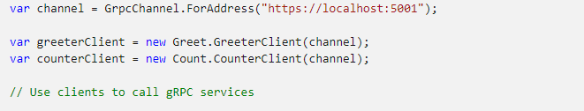
A channel represents a long-lived connection to a gRPC service. When a channel is created, it's configured with options related to calling a service. For example, the HttpClient used to make calls, the maximum send and receive message size, and logging can be specified on GrpcChannelOptions and used with GrpcChannel.ForAddress. For a complete list of options, see client configuration options.
Notes:
https://docs.microsoft.com/en-us/aspnet/core/grpc/configuration?view=aspnetcore-6.0#configure-client-options

Slide 57
Client performance
Channel and client performance and usage:
Creating a channel can be an expensive operation. Reusing a channel for gRPC calls provides performance benefits.
gRPC clients are created with channels. gRPC clients are lightweight objects and don't need to be cached or reused.
Multiple gRPC clients can be created from a channel, including different types of clients.
A channel and clients created from the channel can safely be used by multiple threads.
Clients created from the channel can make multiple simultaneous calls.
GrpcChannel.ForAddress isn't the only option for creating a gRPC client. If calling gRPC services from an ASP.NET Core app, consider gRPC client factory integration. gRPC integration with HttpClientFactory offers a centralized alternative to creating gRPC clients.
Notes:
https://docs.microsoft.com/en-us/aspnet/core/grpc/clientfactory?view=aspnetcore-6.0

Slide 58
Make gRPC calls
A gRPC call is initiated by calling a method on the client. The gRPC client will handle message serialization and addressing the gRPC call to the correct service.
gRPC has different types of methods. How the client is used to make a gRPC call depends on the type of method called. The gRPC method types are:
Unary
Server streaming
Client streaming
Bi-directional streaming

Slide 59

Unary call
A unary call starts with the client sending a request message. A response message is returned when the service finishes.
Each unary service method in the .proto file will result in two .NET methods on the concrete gRPC client type for calling the method: an asynchronous method and a blocking method. For example, on GreeterClient there are two ways of calling SayHello:
GreeterClient.SayHelloAsync - calls Greeter.SayHello service asynchronously. Can be awaited.
GreeterClient.SayHello - calls Greeter.SayHello service and blocks until complete. Don't use in asynchronous code.

Slide 60
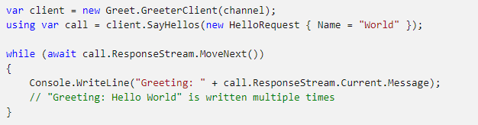
Server streaming call
A server streaming call starts with the client sending a request message. ResponseStream.MoveNext() reads messages streamed from the service. The server streaming call is complete when ResponseStream.MoveNext() returns false.

Slide 61
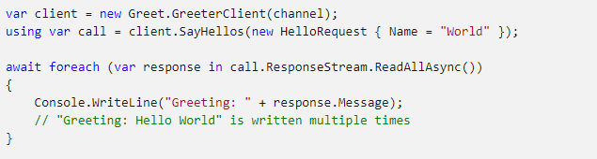
When using C# 8 or later, the await foreach syntax can be used to read messages. The IAsyncStreamReader<T>.ReadAllAsync() extension method reads all messages from the response stream:

Slide 62
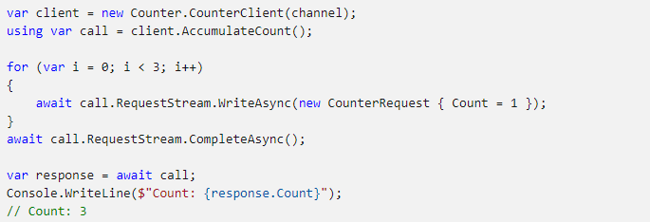
Client streaming call
A client streaming call starts without the client sending a message. The client can choose to send messages with RequestStream.WriteAsync. When the client has finished sending messages, RequestStream.CompleteAsync() should be called to notify the service. The call is finished when the service returns a response message.

Slide 63
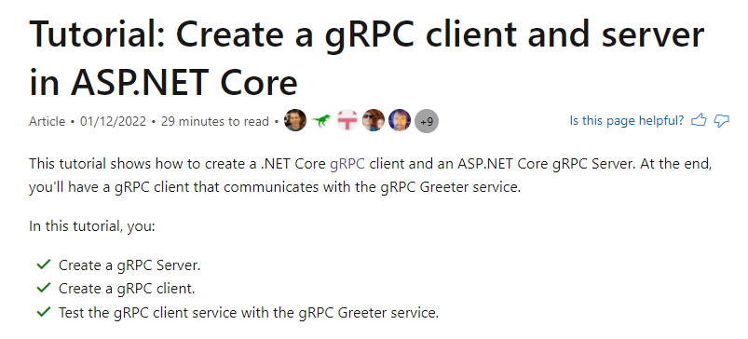
https://docs.microsoft.com/en-us/aspnet/core/tutorials/grpc/grpc-start?view=aspnetcore-6.0&tabs=visual-studio
Notes:
https://docs.microsoft.com/en-us/aspnet/core/tutorials/grpc/grpc-start?view=aspnetcore-6.0&tabs=visual-studio

Slide 64
What’s new for gRPC in .NET 6
gRPC client-side load balancing
Transient fault handling with retries
Protobuf performance
gRPC download speeds
HTTP/3 support
Notes:
https://devblogs.microsoft.com/dotnet/grpc-in-dotnet-6/

